Slide 1
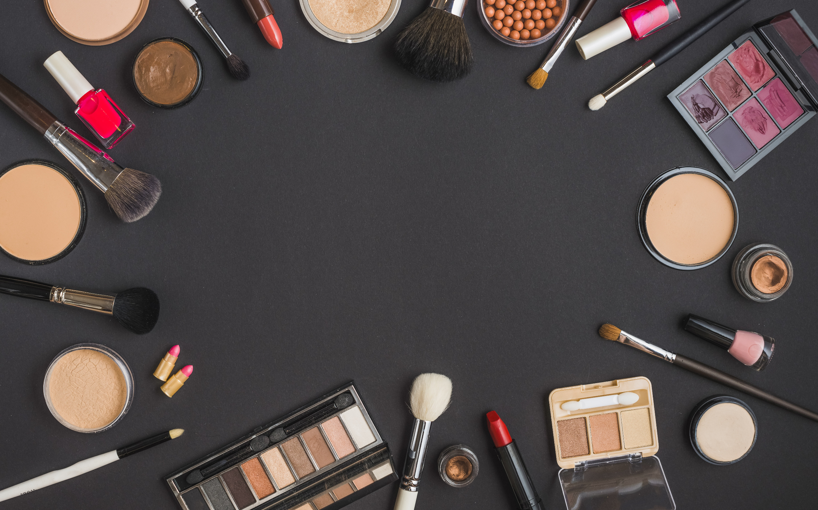
Group 6 SkinCare Products Database
Sungmin Ko, Qi Li, Siyu Liu, Yulin Hou, Xiaoyang Ye, Yuexin Ma
Notes:
Hello, everyone, we are group 6 which is the last group for today’s presentation. I am Sungmin Ko and I will be presenting our project which is skincare product management system along with my team members.

Slide 2
Contents
Database Design Document
ERD
SQL DDL Statement
SQL View
Report & Visualization
Notes:
The following presentation is divided into five parts namely Database design document, ERD, DDL Statement, view and visualization

Slide 3
01 Database Design Document
Map the business purpose to the target database management system with consideration of the business rules.

Slide 4
















Background
1-1 Purpose
Importance of targeting customers’ preferences accurately
Maintain and integrate sales record, customer information and product review
Monitor product sales, dig for potential customers and provide recommend service to the customers
Notes:
In view of the flourishing skincare market,targeting customers’ preferences accurately is of great importance in terms of maintaining a competitive edge.The purpose of the database is to maintain and integrate the data used to meet the needs of sales record management service, customer information management service, review management and other sub-services.
The end users of the system are the retailers. With this system, retailers could monitor product sales, dig for potential customers and provide recommend service to the customers.

Slide 5
Background
1-2 Business Problems
Maintain customer’s information, order information, and product information
Collect the data from each order such as customer’s reviews and volume of sales to evaluate the product
Recommend suitable products based on customer’s personal information
Provide retailers with valuable statistics to forecast customer’s demand and meet supplies
Provide customers with a number of benefits, including subscription service.
Notes:
These are the business problems which our database will help to address. We would like to maintain customer’s information, order information, and product information. and also we want to collect the data from each order such as customer’s reviews and volume of sales to evaluate the product.This will help to recommend suitable products based on customer’s personal information. This system provides retailers with valuable statistics to forecast customer’s demand and meet supplies. also, this system provide customers with a number of benefits, including subscription service and discounting event.Now, my team member Qi Li will explain about the business rules.

Slide 6
Database Design
1-3 Business rules
There are so many business rules we need for our database, but I'll only show some of the most important rules below:
1) Each customer has one email and phone number record stored in the database.
2) Each review record may have an empty or one rating and comment.
3) Each product owns none or more review records.
4) Each order is associated with one retailer.
5) Each customer will have zero or many subscribes.
6) Each product should have one relative product information description.

Slide 7
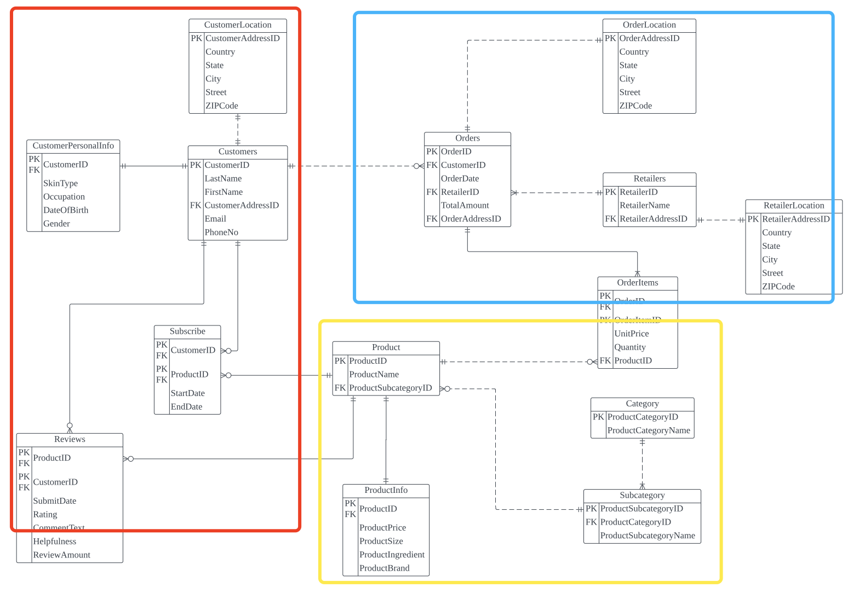
Database Design
2 Database entities and key design decision

Slide 8
Database Design
2 Database entities and key design decision
1) As for the customer-related tables we use customer ID as the primary key to link with other tables, which include: Customer Location, CustomerPersonalInfo, Reviews and Subscribe.
2) For the Orders-related tables we use OrderID as the primary key. But we also have other primary keys to link tables, for example: we use OrderaAddressID as an FK to link OrderLocation table and Orders table. We also use RetailerAddressID to link Retailers and RetailerLocation.

Slide 9
Database Design
2 Database entities and key design decision
3) As for the Product part, it's more complicated. Since we want to give all products a specific category, so we set a Category table and also a Subcategory table.
For example: we set ProductCategoryID from 1101 to 1109 for the Category entity, in which we include skincare products such as mask, foundation and eyecream. We all know that different people have different skin types, so we also set a subcategory to distinguish their skin type such as dryness, oilness, normal, sensitive and so on. In this way, we assume that each customer only has one skin type and it helps us better understand our customers' demand.

Slide 10
02 ERD Design
Give us a better look at the different relationships between the stored data in our database.

Slide 11
ERD

Slide 12
03 The SQL DDL Statements for implementing our Database
Unique scripting allowed our database to accomplish its purpose.
Notes:
After the final design of our ERD, we started the database implementation. In this section, I will introduce the SQL DDL Statement for implementing our database and some unique scripting that allowed our database to accomplish its purpose.

Slide 13
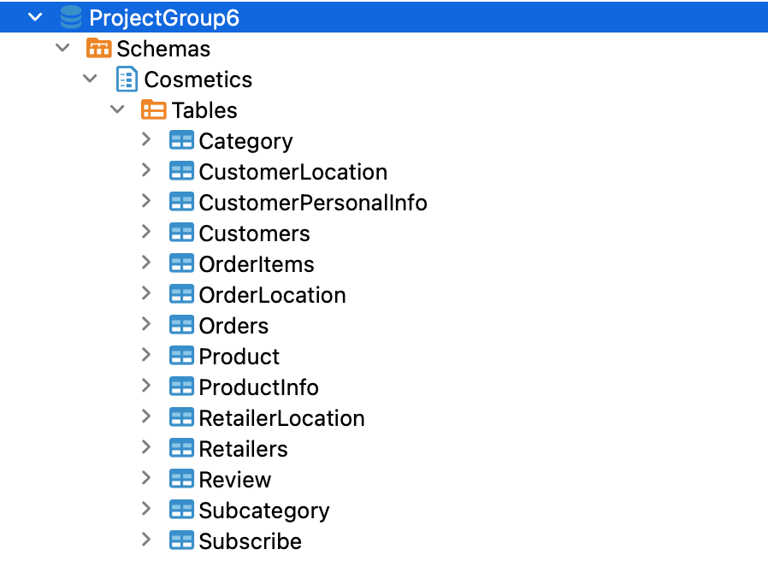
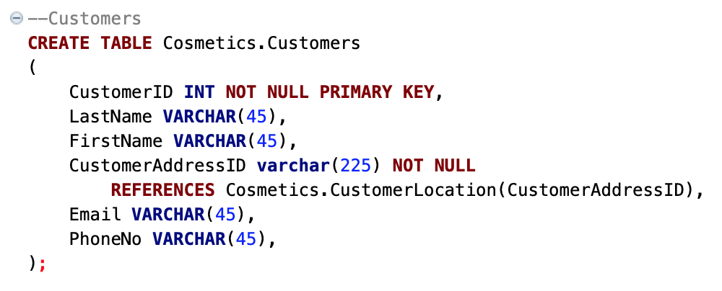
DDL Statement
Create Database: ProjectGroup6
Create Schemas: Cosmetics
Notes:
As shown in the ERD, our database consisted of 14 tables.
First, we use the DDL statement to create our own database and schemas.
Then, we use the DDL statement to create all tables for our database.
Also we identify the primary key and foreign key to build the relationship between our entities

Slide 14
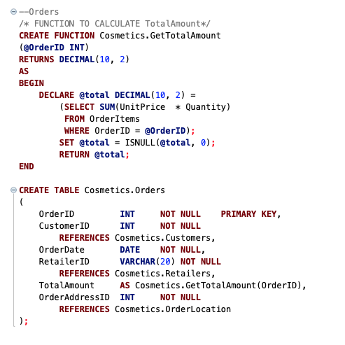
DDL Statement
Featured Table: Cosmetics.Orders
Note: Computed Columns based on a function
Notes:
We used computed columns based on some functions.
This function here will calculate the total amount of each order with the value of unit price and quantity in order items table.
Similarly, we also created a function to count the total number of reviews.
So based on those functions, we could derive some good insights into our database.

Slide 15
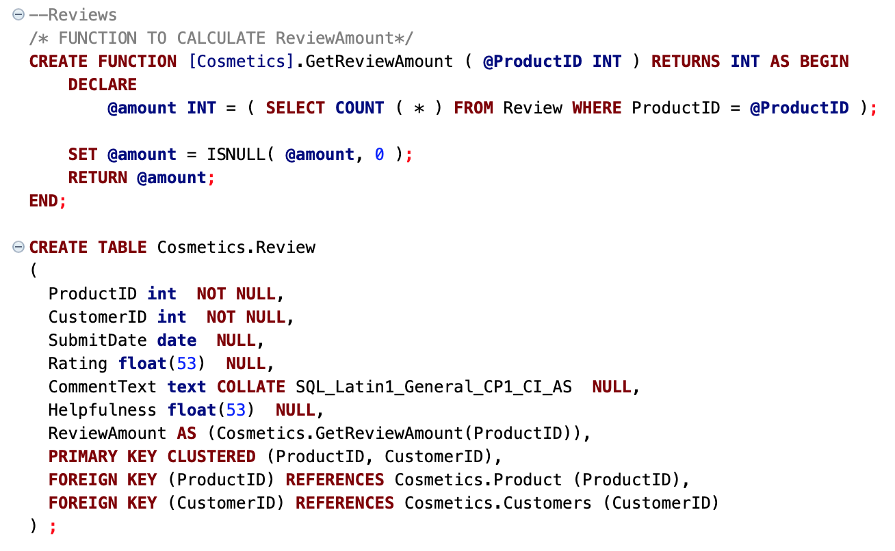
DDL Statement
Featured Table: Cosmetics.Review
Note: Computed Columns based on a function
Notes:
Similarly, we also created another function to count the total number of reviews.
So based on those functions, we could derive some good insights into our database.

Slide 16
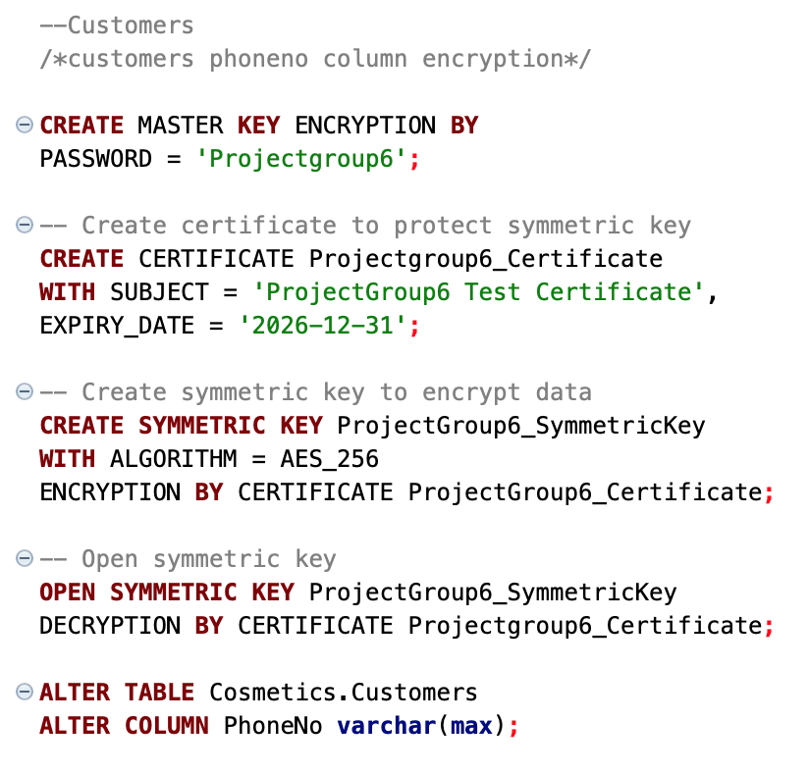
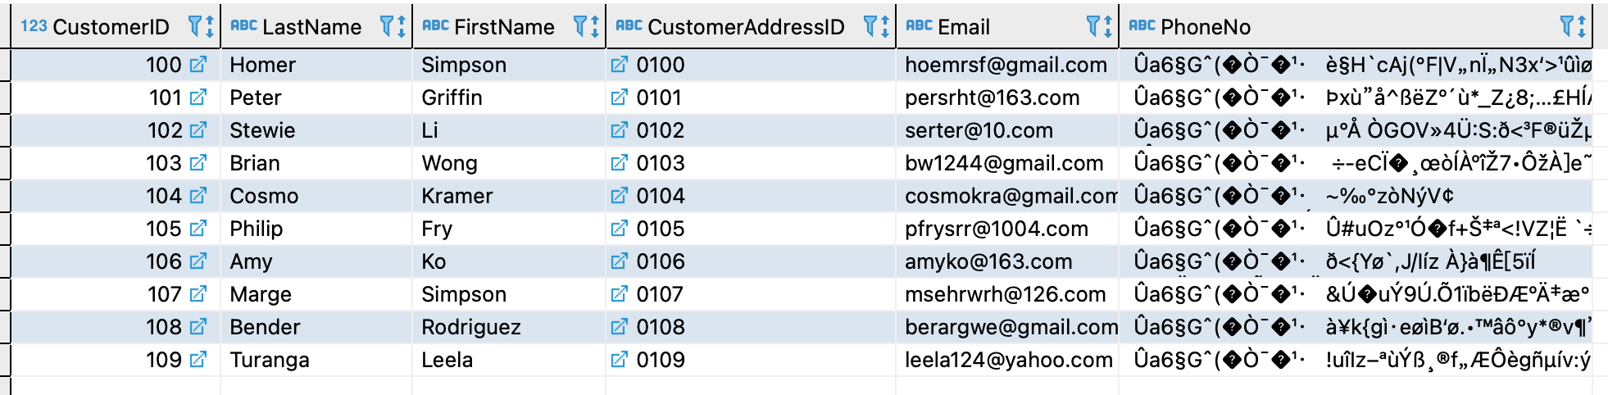
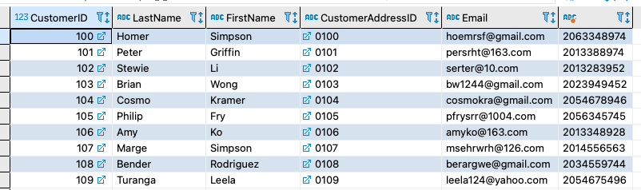
DDL Statement
Featured Table: Cosmetics.Customers
Note: Encrypt the PhoneNumber
Notes:
The next technique we use is encryption. As you can see, there is some private information in our customer table such as phone numbers, and we don’t want that information to be misused by anyone. So we decided to use a simple symmetric key to encrypt customers’ phone numbers.
When we want to get the phone number, we need to use a key first to decrypt it.
In this way, we could protect customers from spam messages and telecom fraud.
Next, we will discuss the views we created for our reporting purposes.

Slide 17
04 SQL View
To focus, simplify, and customize the perception of the database.
Notes:
Next, we will discuss the views we created for our reporting purposes.

Slide 18
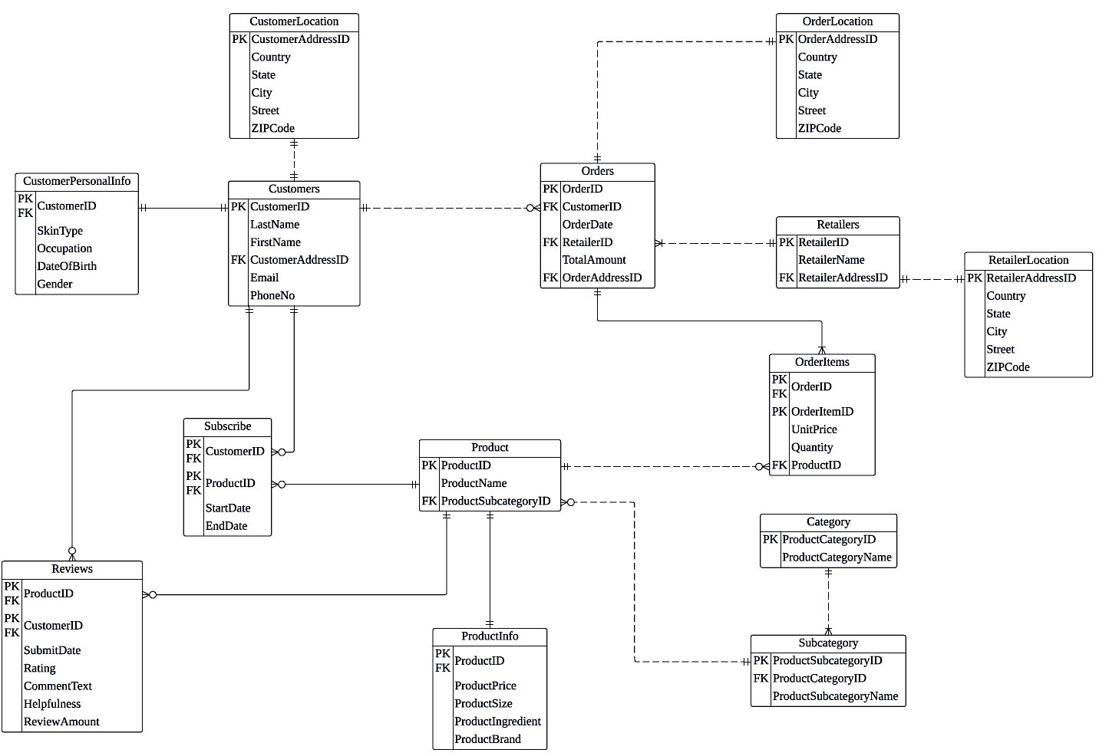
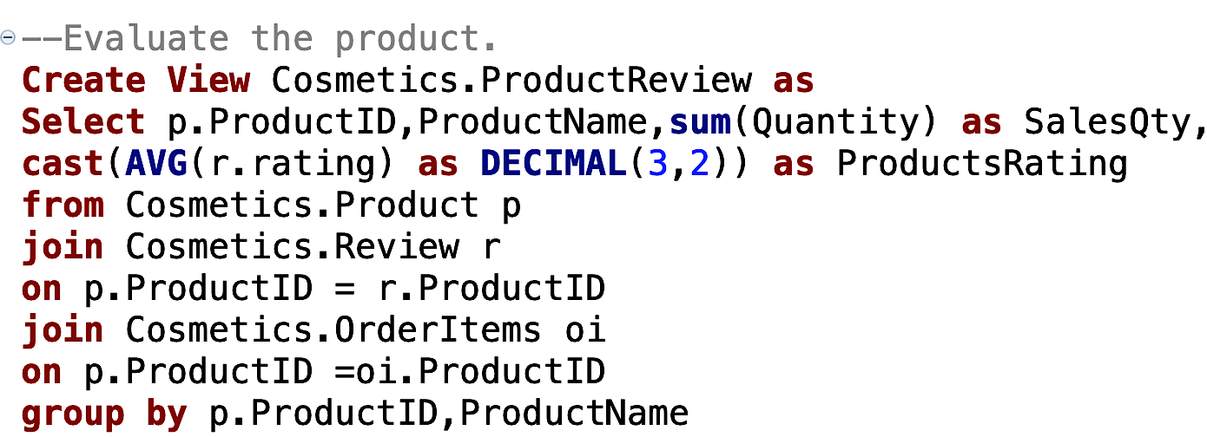
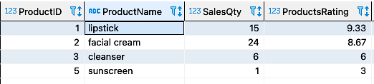
View
View 1: Evaluate the products
Collect the data from each order such as customer’s
reviews and volume of sales to evaluate the product.

Slide 19
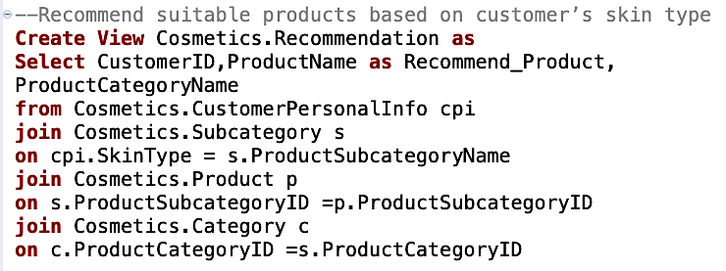
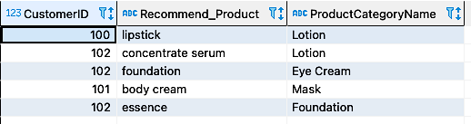
View
View 2: Customer Recommendation
Recommend suitable products based on customer’s
personal information

Slide 20
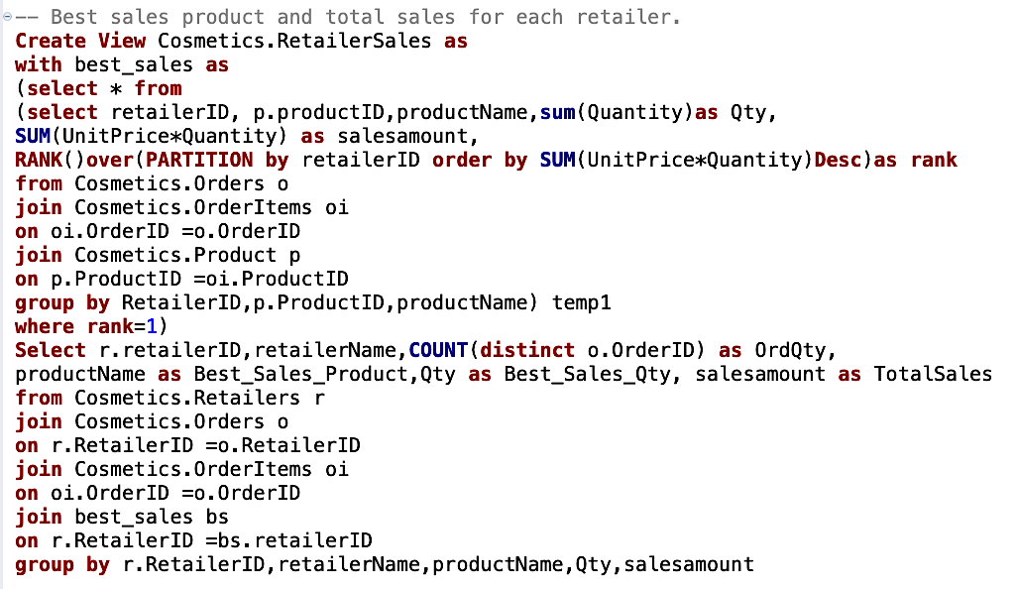
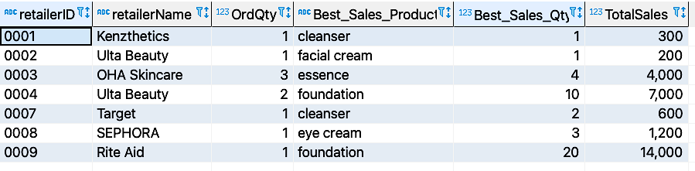
View
View 3: Best sales product
Provide retailers with valuable statistics to forecast
customer’s demand and meet supplies.

Slide 21
05 Report & Visualization
To focus, simplify, and customize the perception of the database by Tableau.

Slide 22
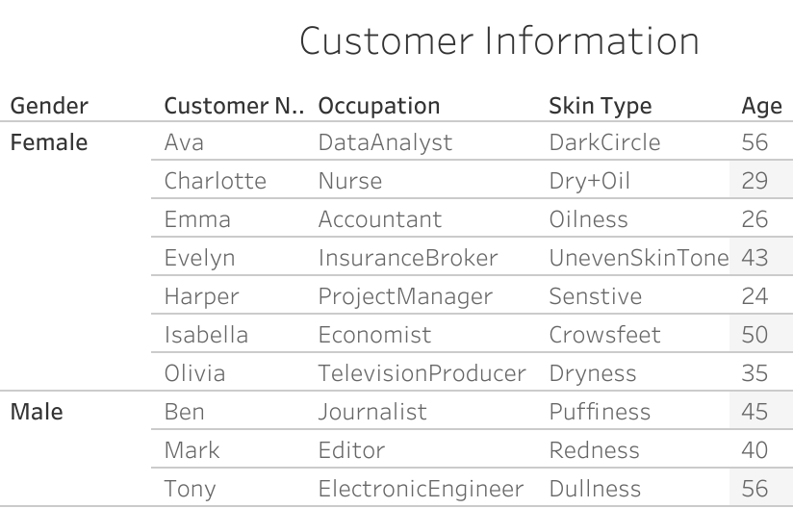
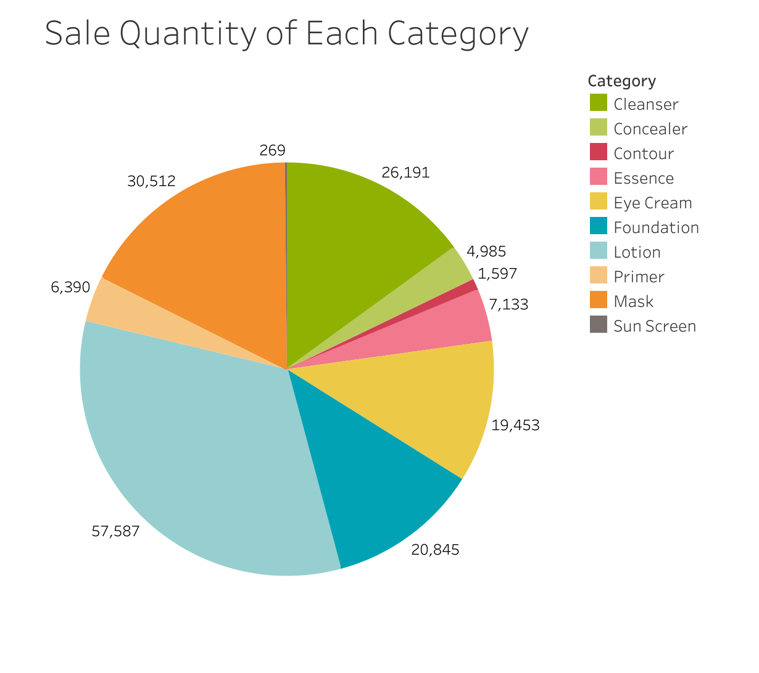
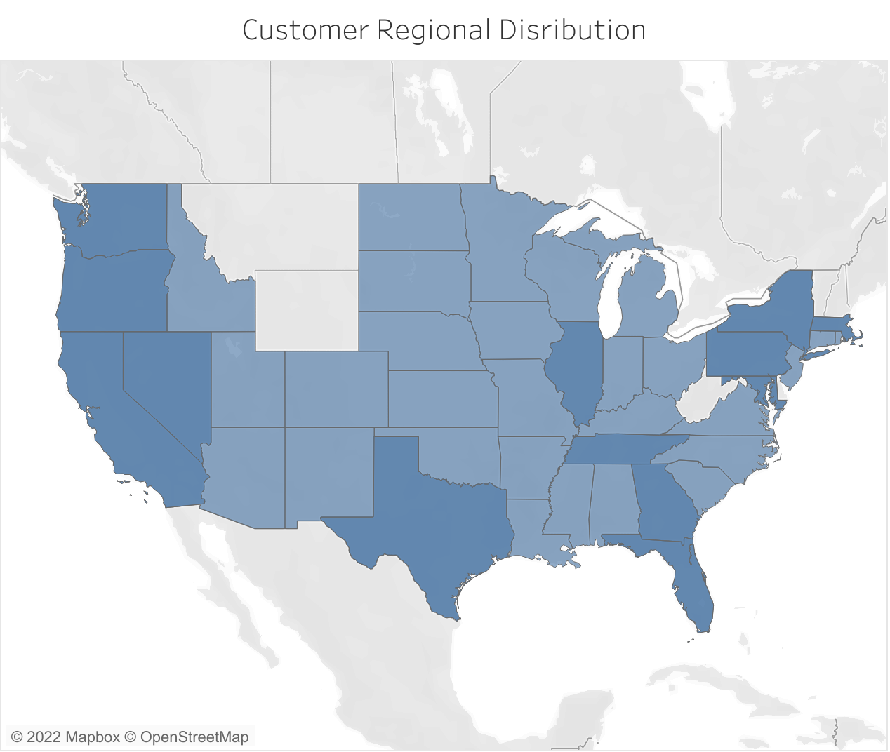
Visualization
Notes:
We create unique, dynamic reports using tableau.
This pie chart demonstrates the sale quantity of each category, obviously, we can find which one contributes the most. So the retailers can monitor product sales according to the chart.
The right table shows the customer information, the retailers can dig for potential customers and provide them recommend service according to their gender, age, skin type etc.
The map below illustrates the customer regional distribution, darker color refers to more customers. They can build more warehouses around the dark states to deploy products.

Slide 23
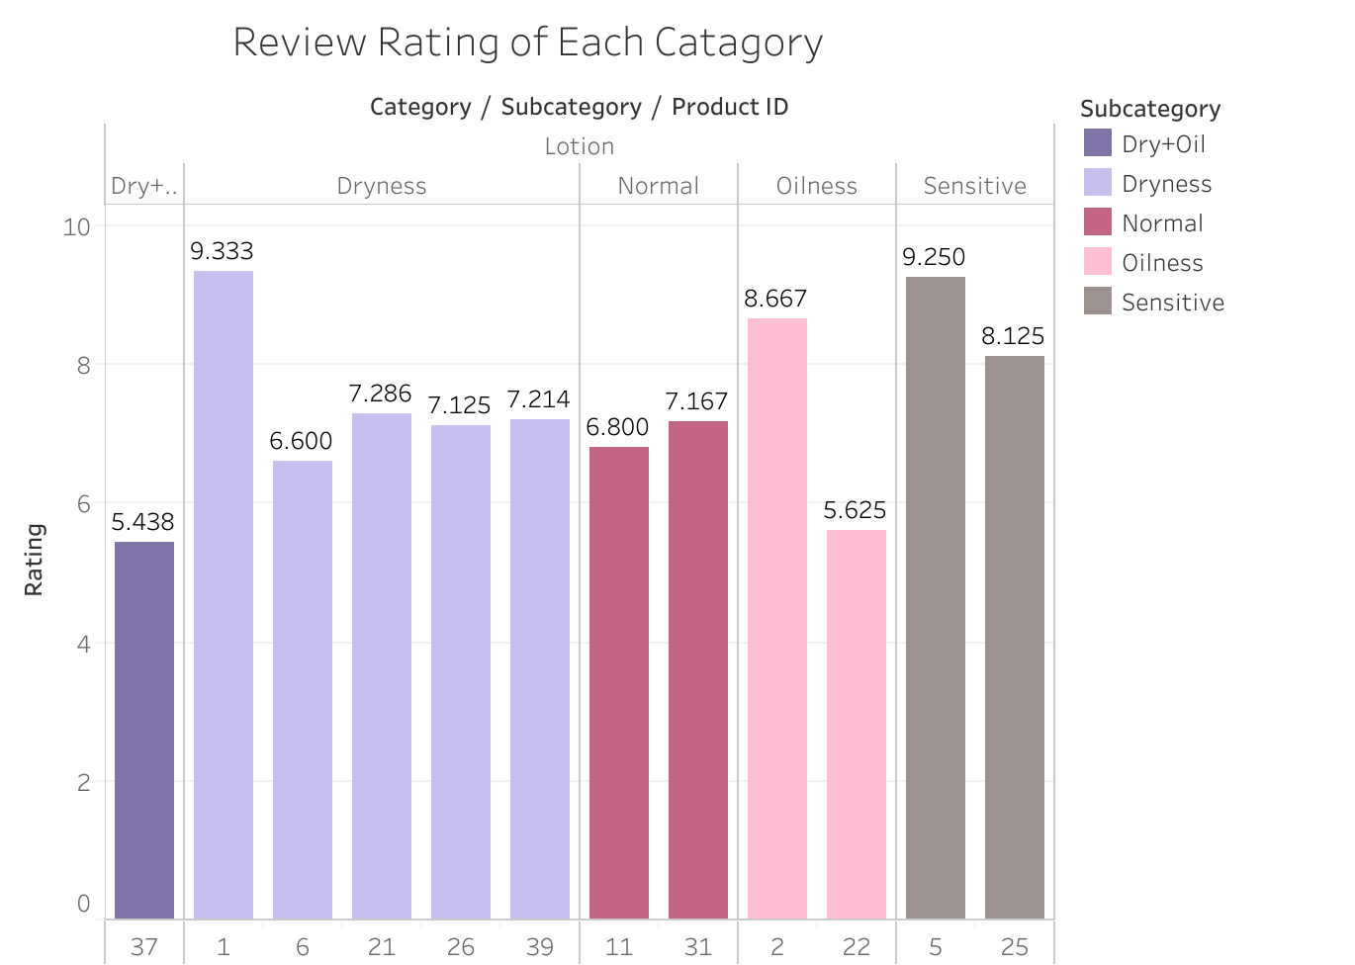
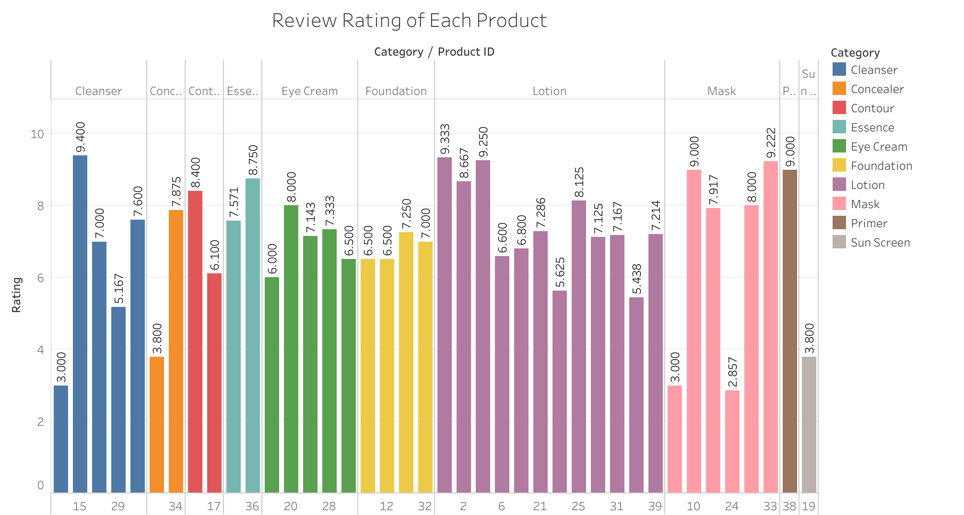
Visualization
Notes:
The bar chart shows the customer reviews of each product of each category. It is a good way to monitor product quality. We can easily find the higher one and increase their supply. For the unwelcome one, we may remove them from shelves.
Similarly, this bar chart shows the review rating of products in a specific category. We can find the highest-rated products of each subcategory and recommend them to customers according to their skin type.

Slide 24
Thank You!
Group6
Sungmin Ko, Qi Li, Siyu Liu, Yulin Hou, Xiaoyang Ye, Yuexin Ma

